Slide 1


ANSI/VITA 74 also known as
A Small Form Factor Module Standard
For Rugged Military, Aerospace
& Industrial Applications

Slide 2
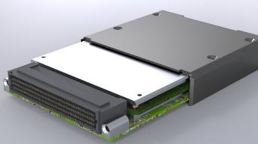
VITA 74 – At a Glance
Plug-In Modules
Standard SWaP
VPX ➔ VNX
Rugged
Conduction Cooled

Slide 3
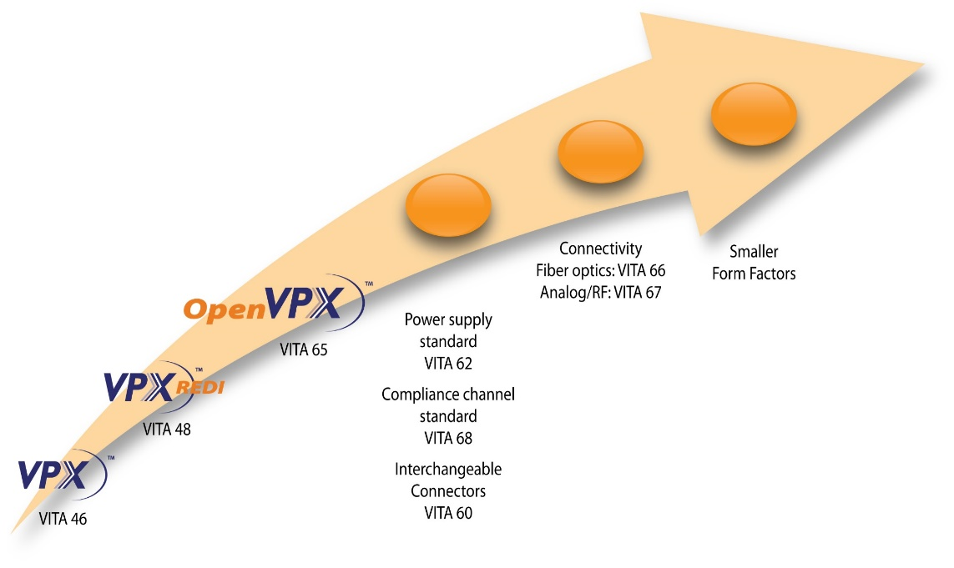

Evolution of VITA 74
VITA 74

Slide 4
VNX History
VITA-74 Technical Committee
2010
2014
VNX Marketing Alliance
Ratified
By
VITA & ANSI
Dec
2017

Slide 5
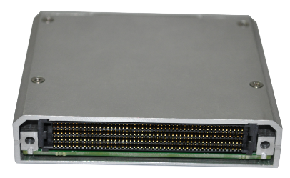
VNX 19mm
Processor Module
Standard Specifies Samtec SEARAY Family Connectors
  19mm VNX Module – 400 Contacts
  Right Angle Connector on Module
  Straight Connector on Backplane
Processor & I/O Applications
Extremely Rugged, Conduction Cooled
High Speed Fabric to 28 Gbps
PCI Express 3rd Generation, and Beyond
89mm X 78mm X 19mm
For More Information
VNX@samtec.com
https://www.trident-sff.com/raptor/

Slide 6
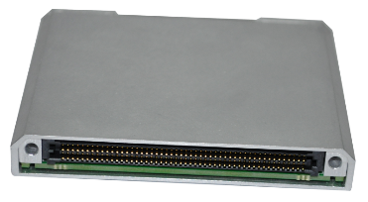
VNX 12.5mm
I/O or Processor Module
Standard Specifies Samtec SEARAY Family Connectors
  12.5mm VNX Module – 200 Contacts
  Right Angle Connector on Module
  Straight Connector on Backplane
I/O, Processor, Navigation & Memory Applications
Extremely Rugged, Conduction Cooled
High Speed Fabric to 28 Gbps
PCI Express 3rd Generation, and Beyond
89mm X 78mm X 12.5mm
For More Information
VNX@samtec.com
https://www.trident-sff.com/raptor/

Slide 7
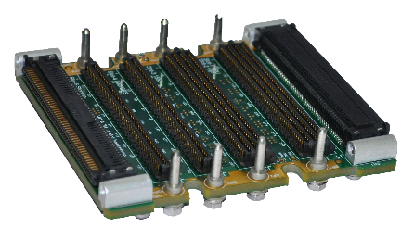
VNX Backplane
Standard Specifies Samtec SEARAY Family Connectors
  19mm VNX Module – 400 Contacts
  12.5mm VNX Module – 200 Contacts
  Right Angle Connector on Module
  Straight Connector on Backplane
Small Form Factor VPX Architecture
Conduction Cooled
High Speed Fabrics to 28 Gbps
PCI Express 3rd Generation, and Beyond
For More Information
VNX@samtec.com
https://www.trident-sff.com/raptor/

Slide 8
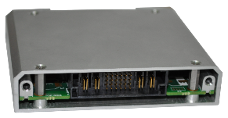
VNX 19mm
Power Supply Module
Samtec POWERSTRIP Connectors
  19mm VNX Module
  Power Rails & Control Signals
  Functionally Equivalent to VITA 62
Power Supply & Hold-Up Configurations
Extremely Rugged, Conduction Cooled
89mm X 78mm X 19mm
For More Information
VNX@samtec.com
https://www.trident-sff.com/raptor/

Slide 9
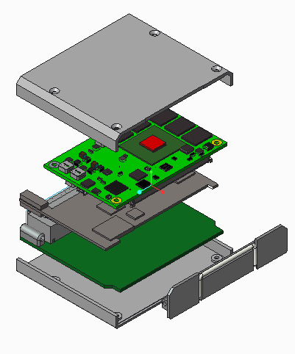
VNX Processor Module Exploded View
Available Processors
Intel Atom
AMD G-SoC
NVIDIA TX2
Power Architecture
ARM
FPGA
System on Module
(SoM)
Heat Spreader
VNX
Basecard
Handle

Slide 10
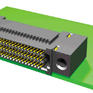
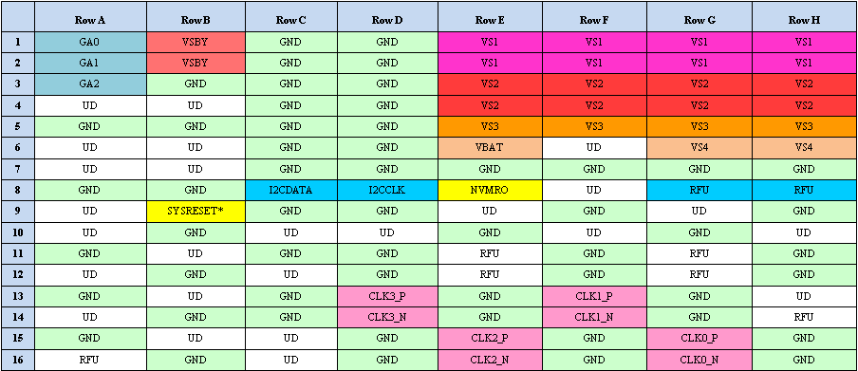
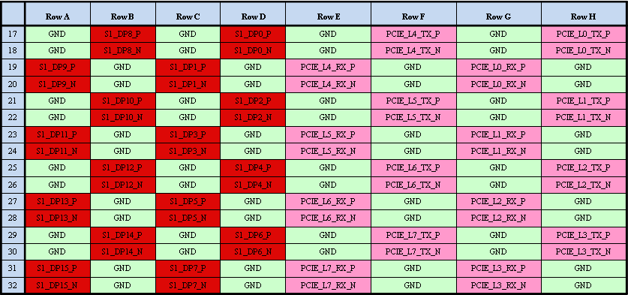
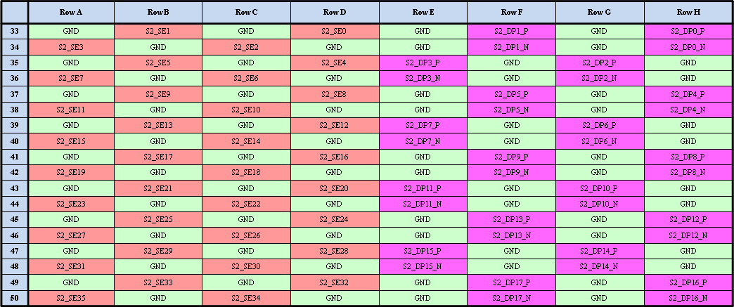

VNX Backplane Connector
Samtec SEARAY™
Samtec SEARAY Series
  Qualified in VITA 57 FPGA Mezzanine Card (FMC) standard
  High Density 4 or 8 rows (200 or 400 pins) with 1.27 mm pitch
  High Speed to 11 Gbps @ 3 dB loss
  Suitable for PCIe Gen2, Gen3 and beyond
  Straight or Right Angle
  BGA or Press Fit
Connector Partitioning Similar to VPX
  S0 Utility Plane
  S1 Fabric
  S2 User I/O
Enhanced Connector Location and ESD Protection
  Separate locator similar to VPX
  May be substituted for RF or optical connector
S0
S1
S2

Slide 11

VNX Processor Module
Typical Slot Profile
S2 Signals
2x Audio In (L-R), 4x SE
2x Audio Out (L-R), 4x SE
2x RS-232 TTL
1x RS-422 (0x)
2x USB 3.0
6x USB 2.0
4x SATA II (1x)
S1 Signals
2x DP (Also LVDS, eDP)
8x PCIe (2x X2 Rings)
1x GigE
1x GigE (SerDes)
8x GPIO (SE)
S0 Signals
RST
4x PCIe Clocks
1x I2C
1x SMB
1x WDT
1x RC

Slide 12
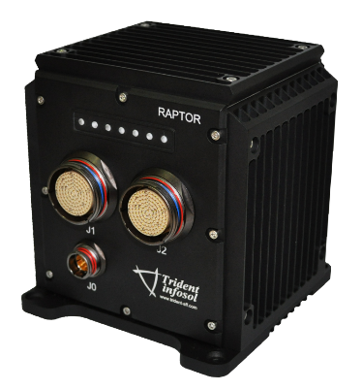
ANSI/VITA 74.0-2017 “VNX”
Integrated System (Raptor)
Integrated VNX System
  1x 19mm Processor Module
  2x 12.5mm I/O Modules
  2x Power Supply Modules
  mPCIe / mSATA Storage & I/O
VNX is Small Form Factor VPX Architecture
Conduction Cooled
High Speed Fabrics to 28 Gbps
PCI Express 3rd Generation, and Beyond
For More Information
VNX@samtec.com
https://www.trident-sff.com/raptor/

Slide 13
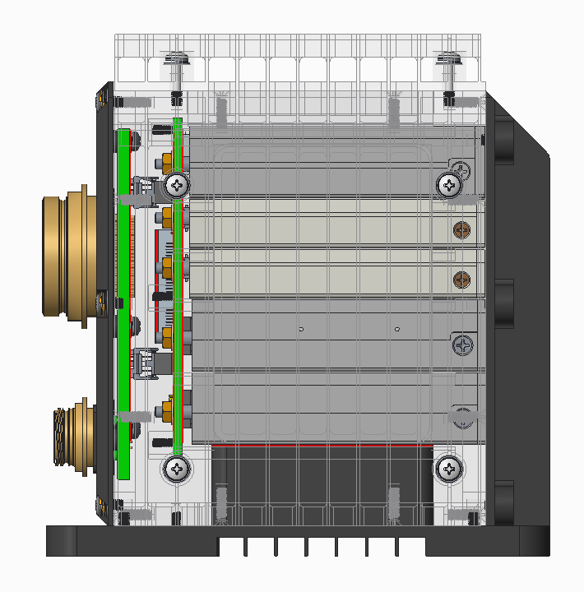
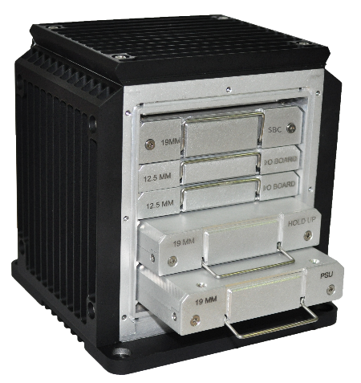

Typical VNX System
Mechanical Design
Side X-Ray View
Rear Panel Removed

Slide 14
Block Diagram – Raptor (1+2)
5 Slots
Power Supply
Filter
Processor
I/O #1
I/O #2

Slide 15
Thank You !
For More Information
VNX@samtec.com info@trident-sff.com
http://www.samtec.com/standards/vita/vnx
https://www.trident-sff.com/raptor/
Samtec Confidential

