Slide 1
Extending SI Perf in Right-Angle VNX Connectors Using Ground Mode Resonance Suppression
Presented by: Burrell Best
VSO Meeting - San Pedro, CA - July 2018

Slide 2
agenda
Problem, Objective, & Summary
Test Board Design Overview
PCIe Simulation Performance Summary
De-embedded Measurement Results
Conclusions
Back-up

Slide 3
problem
  High-density open pin-field designs offer flexibility to system designers, but with limitations above 10Gbps.
  Open pin field designs are inherently prone to resonances originating through the ground pin connections. This is commonly called ground mode resonance (GMR).
  Because of varying pin lengths in right-angle connectors, GMR will effect each row differently.
  GMR must be considered when designing channels above 10Gbps using open pin field RA VNX connectors.

Slide 4
Objective
Demonstrate Resonance Suppression:
  Show that resistors dampen sharp resonances in the frequency domain.
  Show improvements in signal eye height and eye width.
  Show that higher frequency applications are possible with VNX Right Angle connectors when using damping resistors.
Analyze Performance:
  Using the SEASIM (0.74) simulation tool, characterize PCIe G4/G5 channel performance using the SEARAY™ Right Angle (RA) connectors.
  Compare the performance with/without suppression resistors.

Slide 5
summary
  De-embedded connector models used in simulations confirm that improvements in the connectors performance are realized when the suppression resistors are used.
  This can be observed in both the connector frequency domain measurements and the channel simulation results.
  Resonances are more prevalent for the longer pin paths without damping resistors.
  With damping resistors, Samtec’s right angle SEARAY™ connector can pass channels up to and including PCIE Gen5 (32GT/s).

Slide 6
Test BOARD design overview

Slide 7
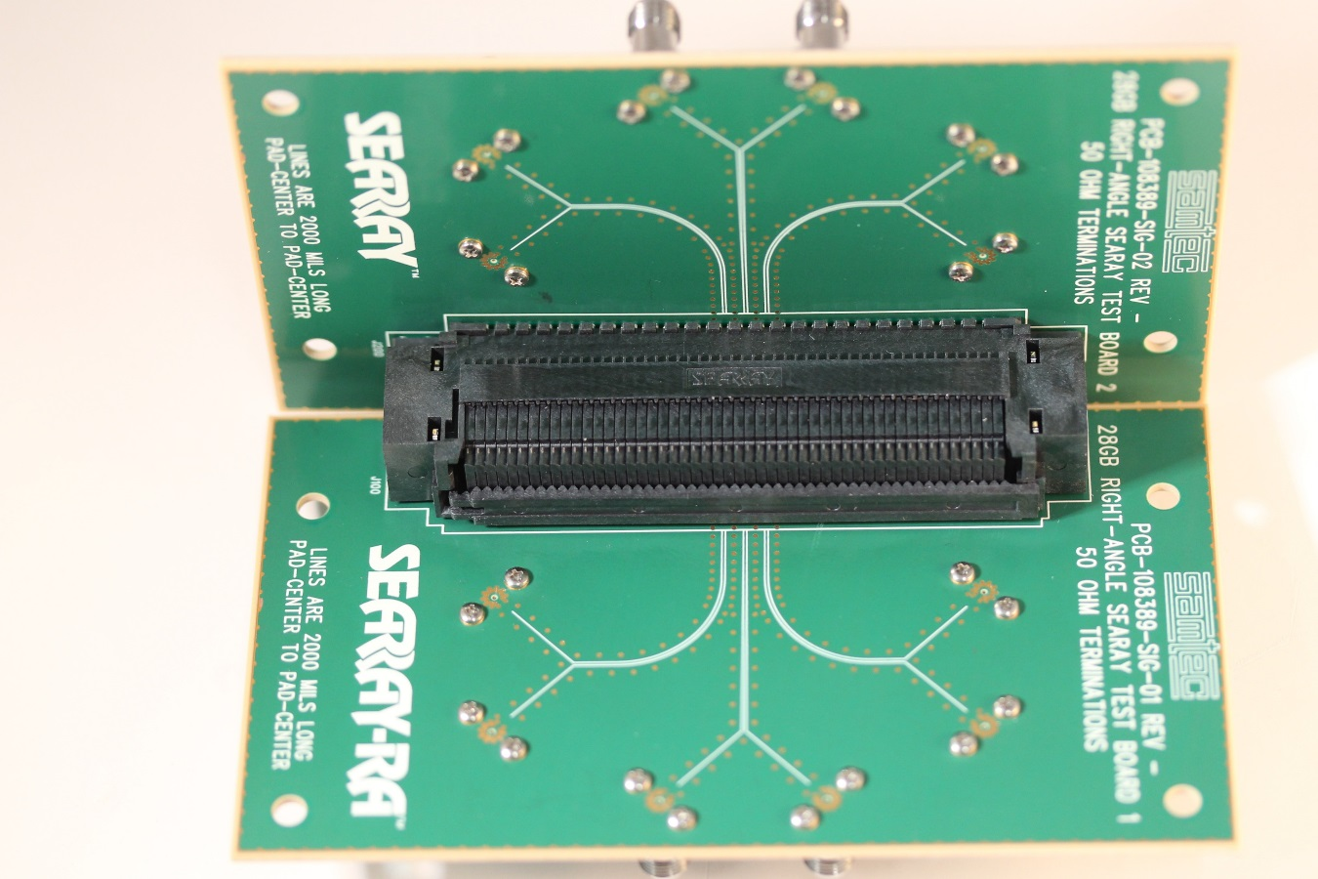
Test board design overview
Board Material – Isola 1067
2” 100Ω differential strip lines
Traces isolated by ground Vias
2.92 mm SMA ports
10Ω damping resistors were installed on the back side of both boards.
Signal Vias back drilled to reduce stub resonances

Slide 8
Approximate equivalent circuit
Ground return damping resistors
Ground return damping resistors

Slide 9
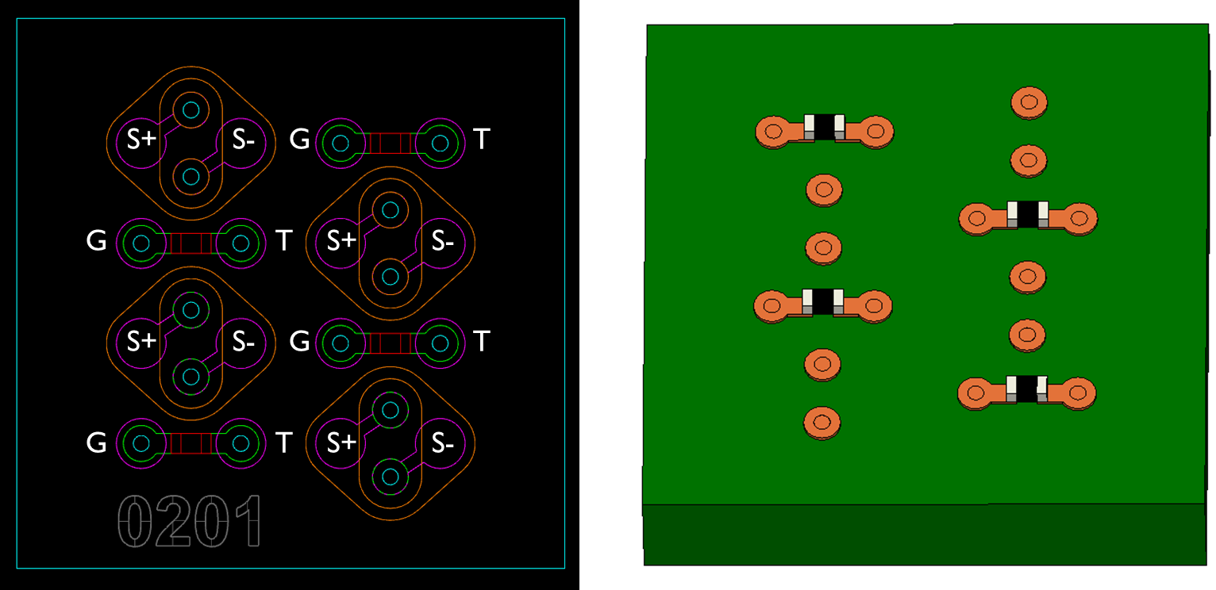
Example of Resistor placement
Note: Routing channel reduced, but still routable

Slide 10
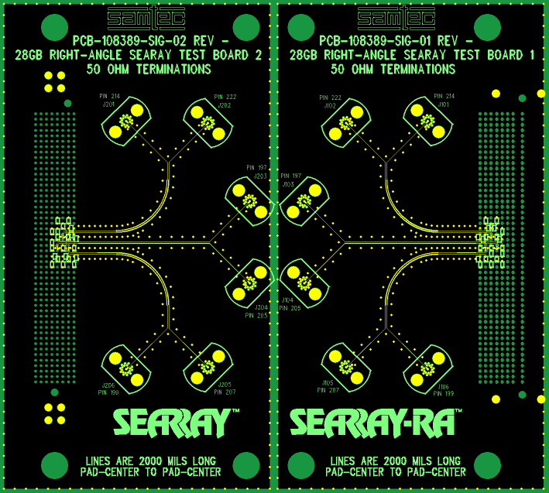
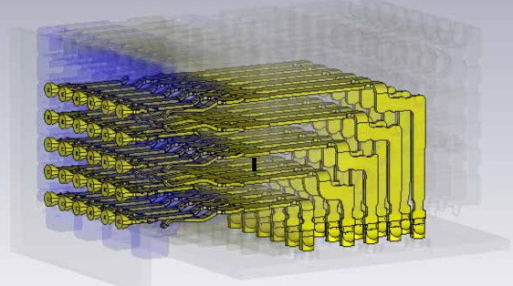
Test Board Wiring Diagram
Signaling order ‘SSGGSS’ and ‘GGSSGG’
Electrical length increases from row A to H
6 | 5 | 4 | 3 | 2 | 1 | Row
NC | NC | gnd | gnd | NC | NC | H
gnd | gnd | p207 | p199 | gnd | gnd | G
p222 | p214 | gnd | gnd | gnd | gnd | F
gnd | gnd | p205 | p197 | gnd | gnd | E
NC | NC | gnd | gnd | NC | NC | D
NC | NC | NC | NC | NC | NC | C
 |  |  |  |  |  | B
 |  |  |  |  |  | A
H
A

Slide 11
PCIe Simulation Performance Summary

Slide 12

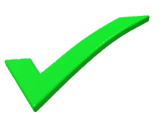
PCIE Gen4 (FR4) – xTalk Simulation
Victim | Resistor | EH | EW | Meet Spec
P214, P222 | No | 75.3 mV | .546 UI | Yes
P214, P222 | Yes | 75.4 mV | 0.558 UI | Yes
Module 1
Aggressors
G4 Passing Criteria:
EH > 15.0 mV
EW > 0.3 UI
6 | 5 | 4 | 3 | 2 | 1 | Row
NC | NC | gnd | gnd | NC | NC | H
gnd | gnd | p207 | p199 | gnd | gnd | G
p222 | p214 | gnd | gnd | NC | NC | F
gnd | gnd | p205 | p197 | gnd | gnd | E
NC | NC | gnd | gnd | NC | NC | D
NC | NC | NC | NC | NC | NC | C
Victim
Len 1 = 4”
Len 2 = 4”
Backplane

Slide 13

PCIE Gen4 (FR4) – performance by pin pair
Without Resistors
Pins | EH | EW
197, 205 (Short) | 83.9 mV | 0.546
214, 222 (Med) | 76.8 mV | 0.551
199, 207 (Long) | 75.6mV | 0.518
G4 Passing Criteria:
EH > 15.0 mV
EW > 0.3 UI
Module 1
Modest Improvement
Len 1 = 4”
With Resistors
Pin Pairs | EH | EW | EH ∆ | EW ∆
197, 205 (Short) | 81.6 mV | 0.558 | -2.8% | +2.2%
214, 222 (Med) | 78.7 mV | 0.565 | +2.4% | +2.5%
199, 207 (Long) | 79.8 mV | 0.575 | +5.3% | +11.0%
Len 2 = 4”
Backplane

Slide 14

PCIE Gen5 (FR4) – xTalk Simulation
Victim | Resistor | EH | EW | Meet Spec
P214,P222 | No | 10.8 mV | 0.195 UI | No
P214,P222 | Yes | 24.0 mV | 0.358 UI | Yes
Module 1
Aggressors
G5 Passing Criteria:
EH > 10.0 mV
EW > 0.3 UI
6 | 5 | 4 | 3 | 2 | 1 | Row
NC | NC | gnd | gnd | NC | NC | H
gnd | gnd | p207 | p199 | gnd | gnd | G
p222 | p214 | gnd | gnd | NC | NC | F
gnd | gnd | p205 | p197 | gnd | gnd | E
NC | NC | gnd | gnd | NC | NC | D
NC | NC | NC | NC | NC | NC | C
Victim
Len 1 = 4”
Len 2 = 4”
Backplane

Slide 15
PCIE Gen5 Simulation (FR4) – performance Comparison by pin pair
Without Resistors
Pins | EH | EW
197, 205 (Short) | 24.2 mV | 0.329
214, 222 (Med) | 15.2 mV | 0.245
199, 207 (Long) | 15.8 mV | 0.240
G5 Passing Criteria:
EH > 10.0 mV
EW > 0.3 UI
Module 1
Exceptional Improvement
Len 1 = 4”
With Resistors
Pin Pairs | EH | EW | EH ∆ | EW ∆
197, 205 (Short) | 32.5 mV | 0.403 | +34% | +23%
214, 222 (Med) | 31.8 mV | 0.410 | +109% | +67%
199, 207 (Long) | 31.4 mV | 0.400 | +99% | +67%
Len 2 = 4”
Backplane
Notes:
Pin to pin comparison using the thru measurements only, using the non-crosstalk connector model
Pin paths are described by length in comparison to each other
Enormous gains are seen when using the resistors on the longer pin paths
Again the resistors open the signal eye on the med and long pin paths
This supports the previous G5 xtalk simulation

Slide 16
Searay™ (RA) mated Connector results
The effect of the damping resistors in the Gen4 simulation is to increase the eye-width up to +11% while having a small effect on the eye-height.
The effect of the damping resistors in the Gen5 simulation is astonishing, yielding eye-height improvements of +109% and eye-width improvements of +67%.
This is achieved by the reduction of the jitter in the rising and falling edges by the resistor damping elements.
The addition of damping resistors improves the SEARAY™ RA performance enough to pass PCIE Gen5 (32GT/s) channels.

Slide 17
De-embedded Measurement Results

Slide 18
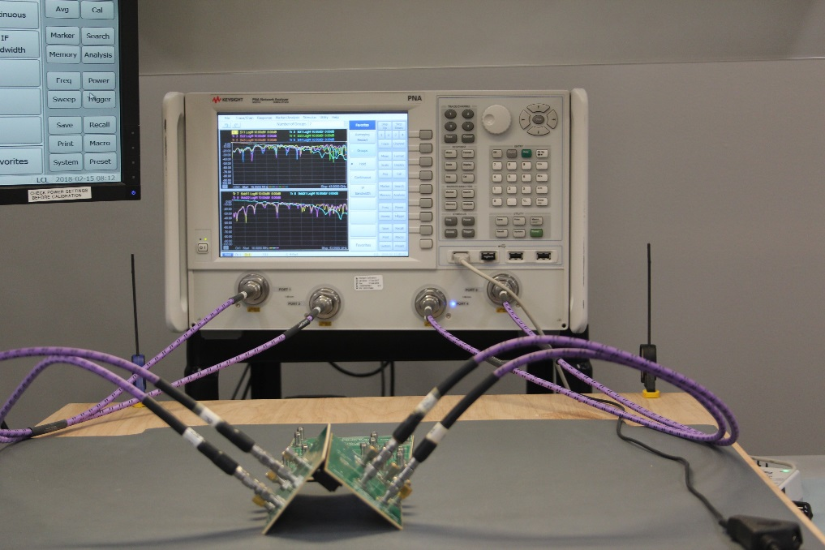
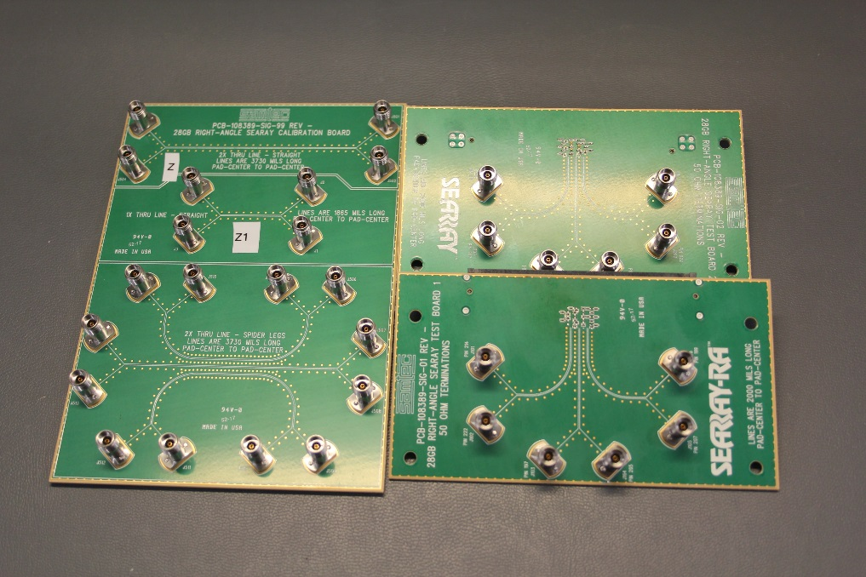
SETUP for searay™ Measurements
Keysight N5227A 67GHz Microwave Network Analyzer for Return Loss, Insertion Loss and Crosstalk (NEXT and FEXT) measurements.
Two test boards (one populated with damping resistors) and a calibration board
The SEARAY™ Connector S-parameter models were extracted from VNA measurements using a 2x thru style de-embedding tool.

Slide 19
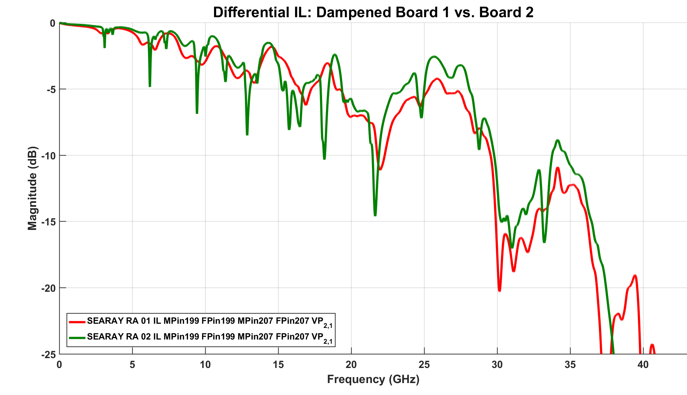
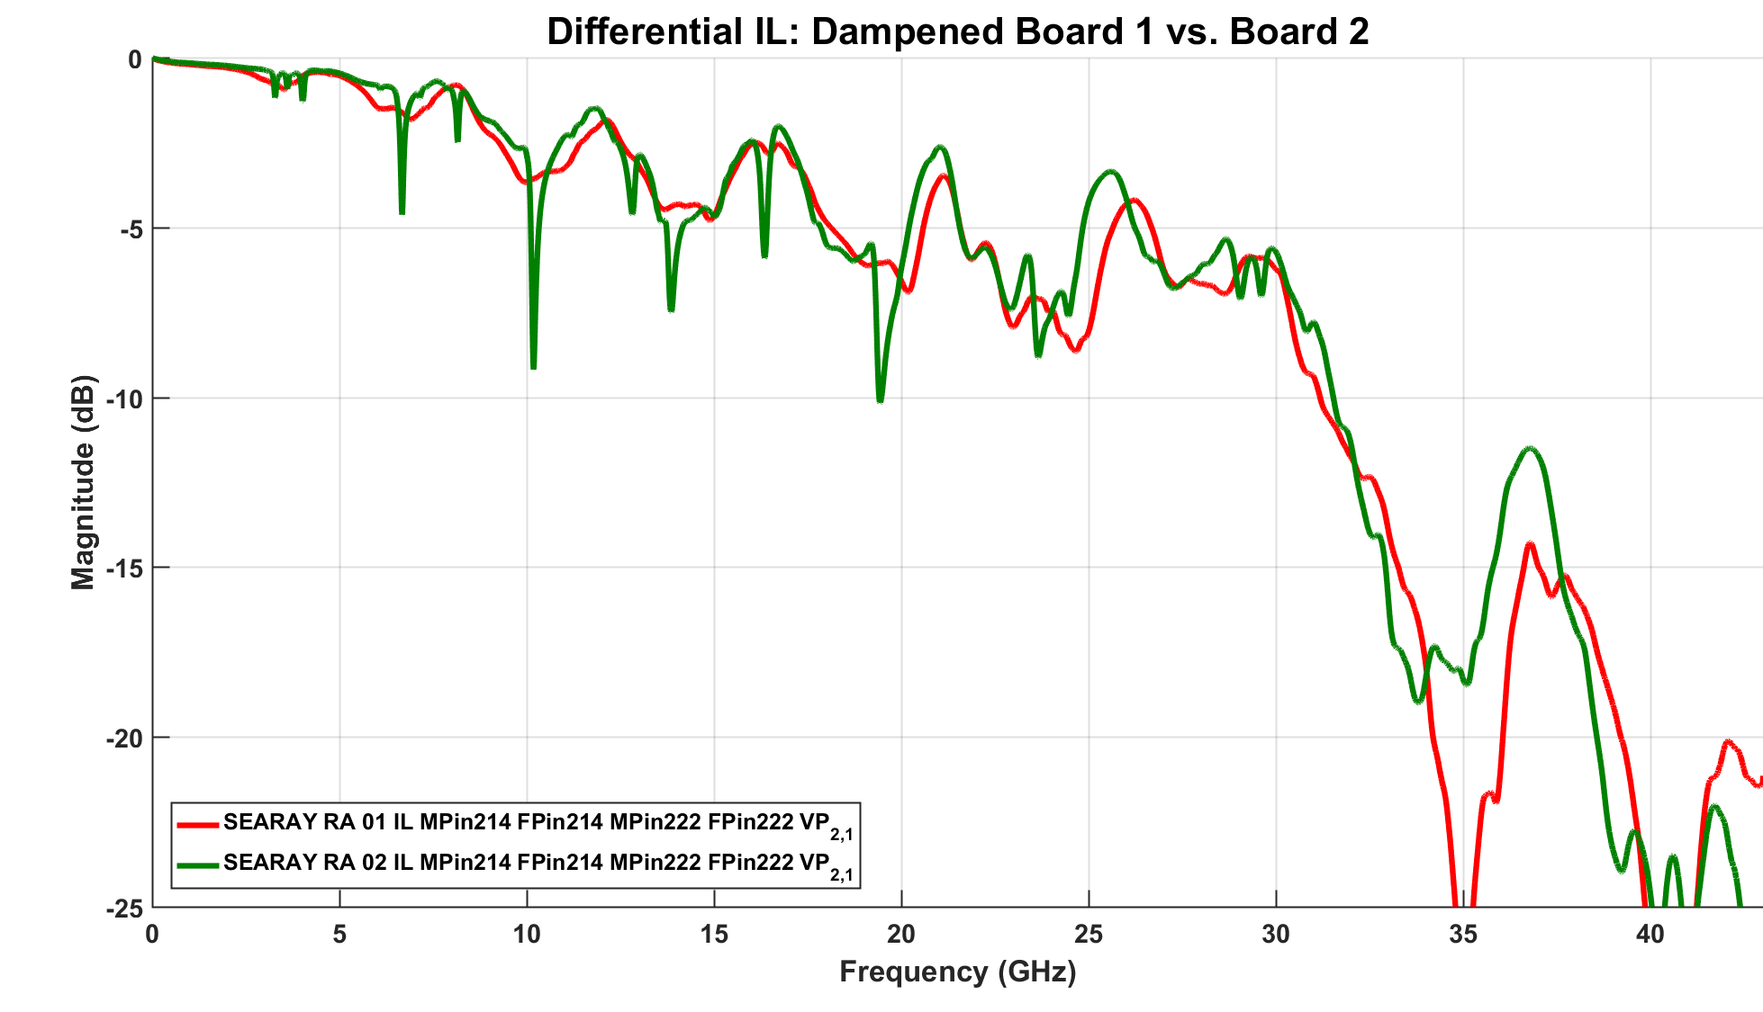
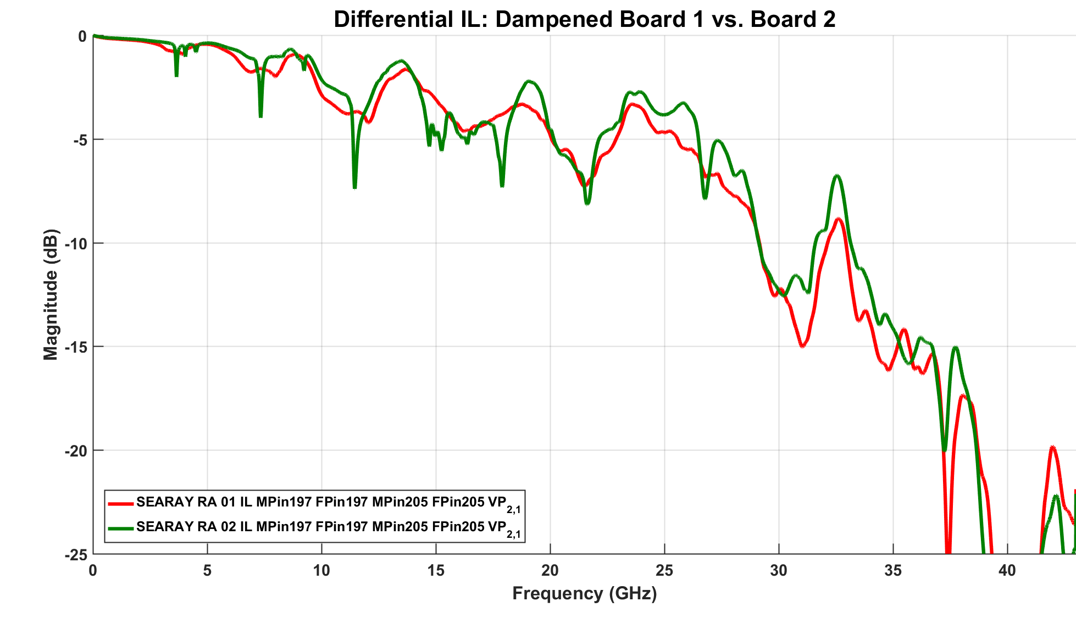
De-embedded insertion (il) Comparison
Resonances get sharper with pin length through the connector
RED Plots with Resistors
Long
4 | 3 | 2 | 1 | Row
 |  | p207 | p199 | G
p222 | p214 |  |  | F
 |  | p205 | p197 | E
Medium
Short

Slide 20
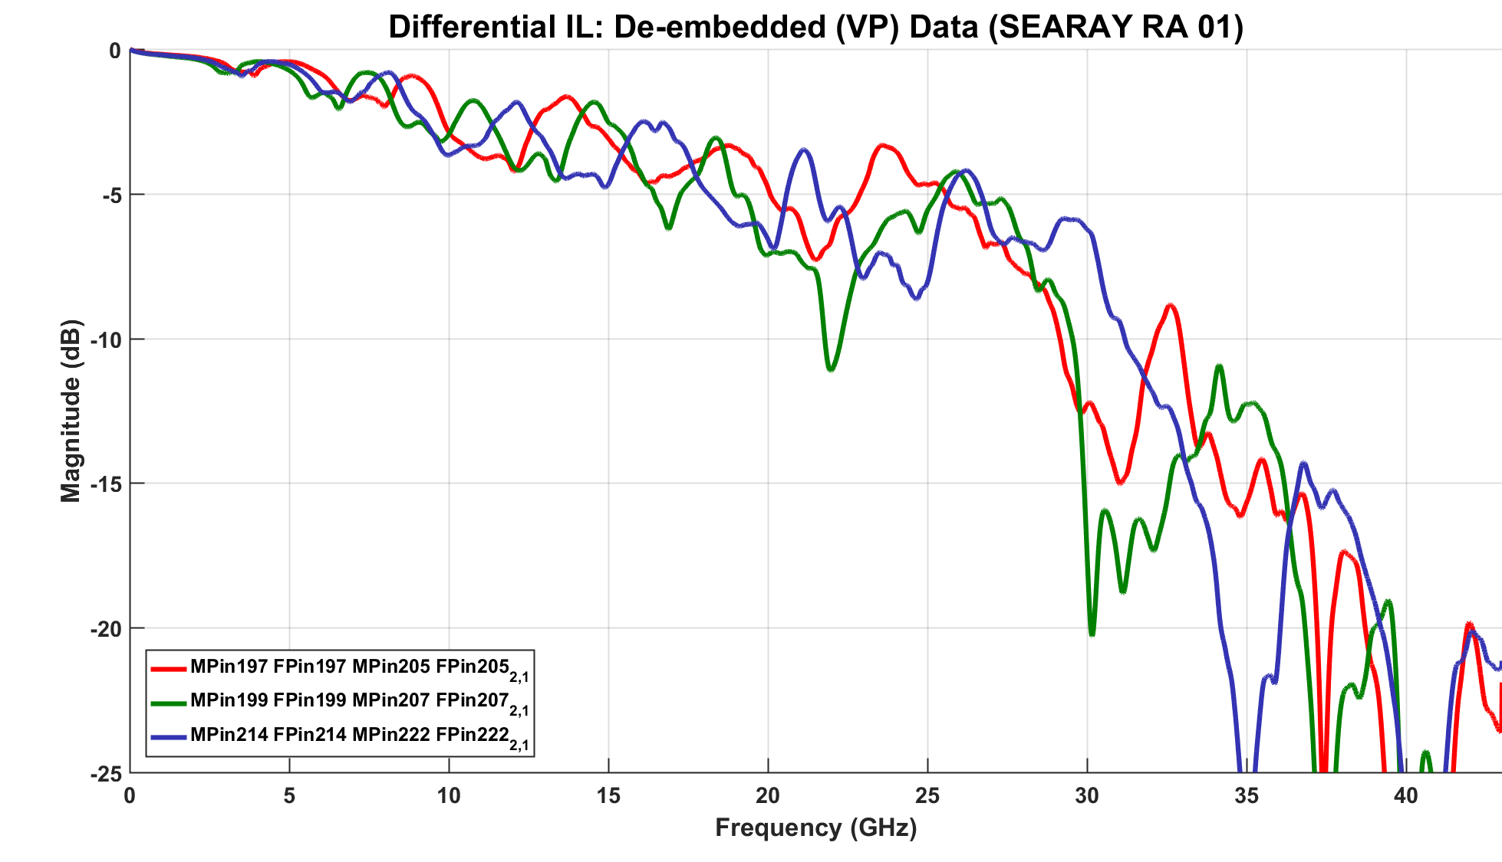
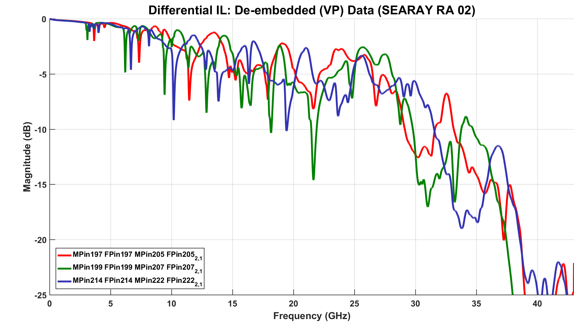
De-embedded Connector Measurements - Il
With 10Ω Dampening Resistor Without Resistor
Note: Reduced resonance spikes
PCIe Gen 4 Data Rate
16

Slide 21
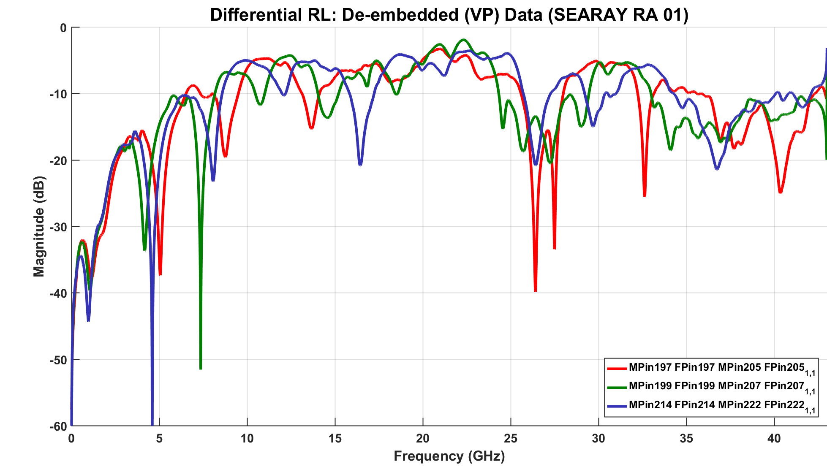
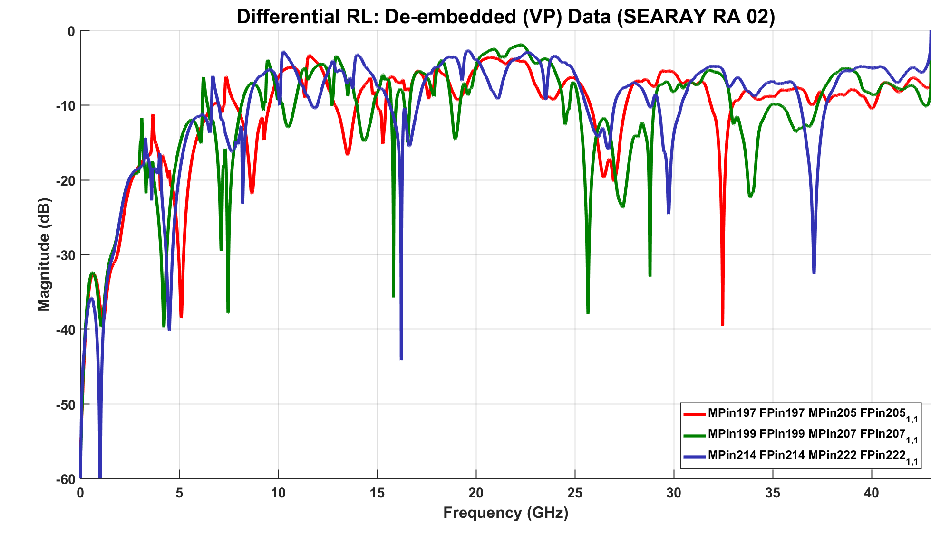
De-embedded Connector Measurements – RL
With 10Ω Dampening Resistor Without Resistor

Slide 22
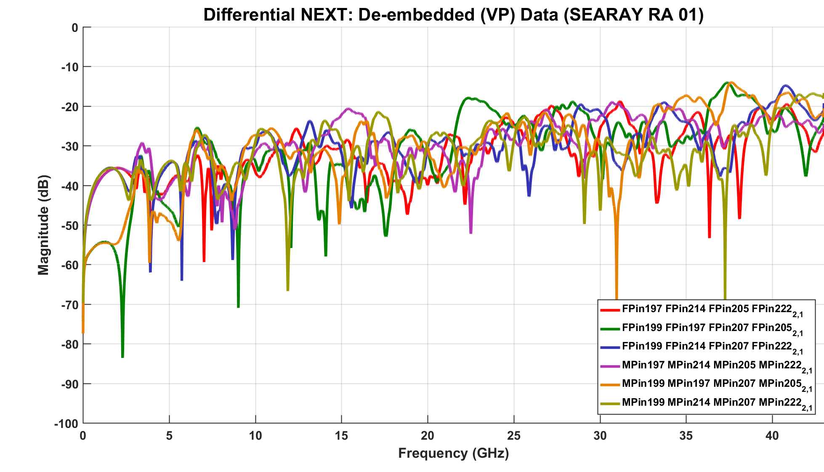
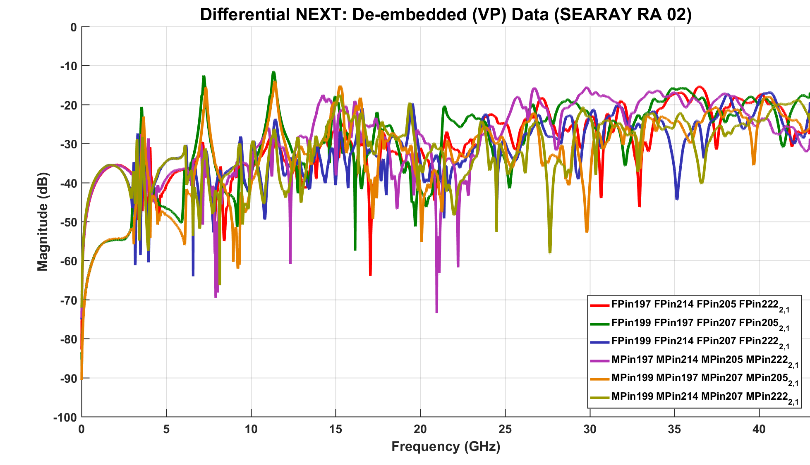
De-embeded Connector Measurements – NEXT
With 10Ω Dampening Resistor Without Resistor

Slide 23
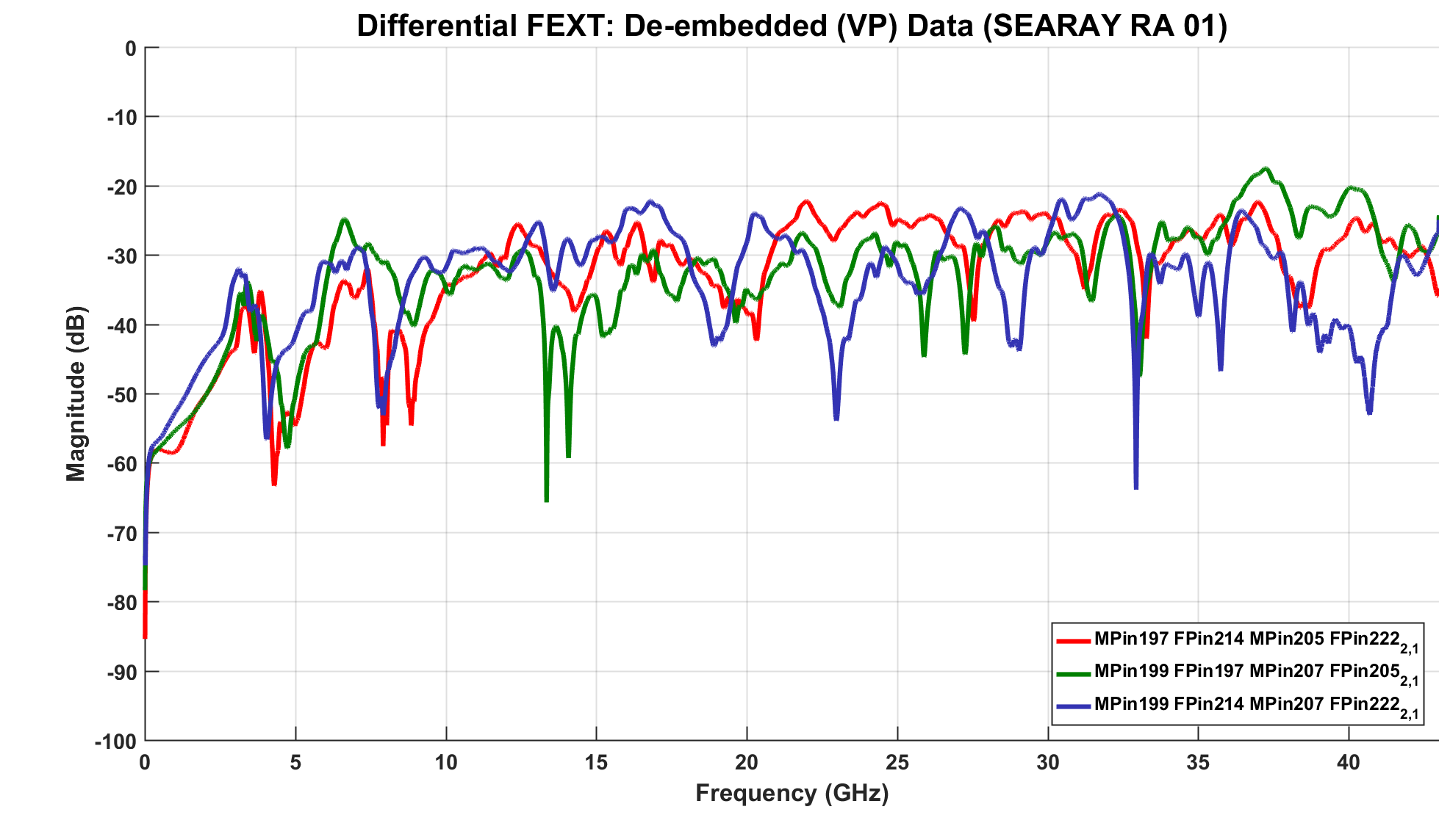
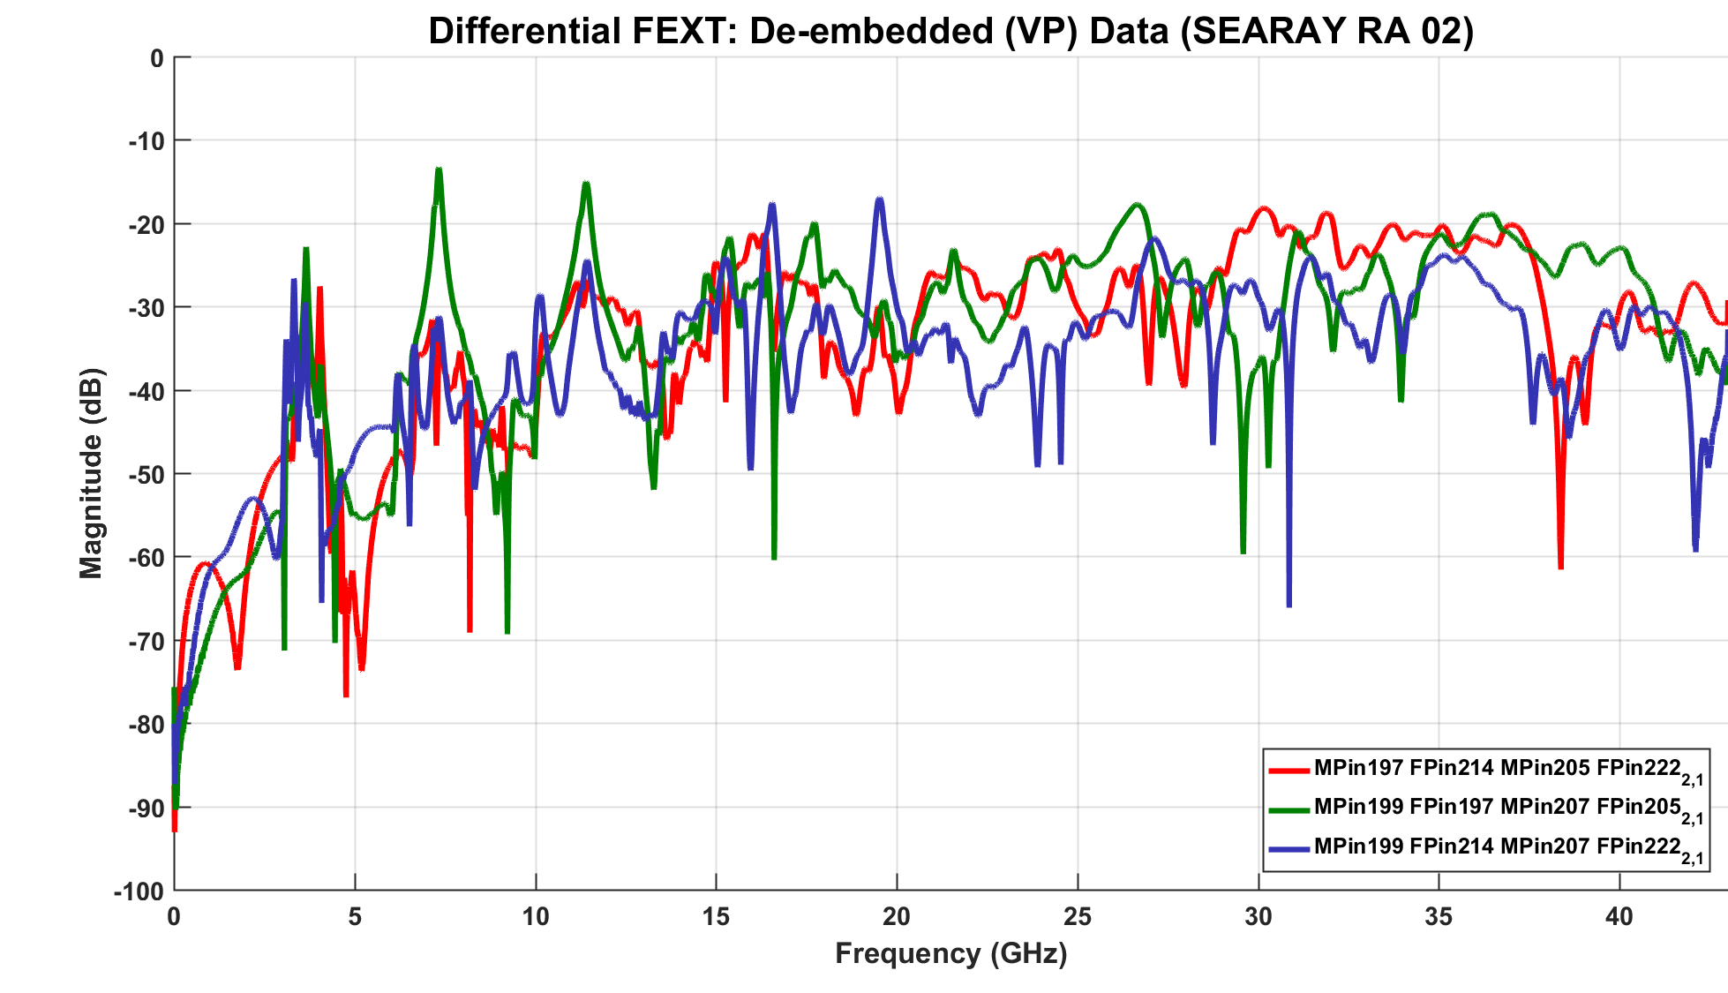
De-embedded Connector Measurements – Fext
With 10Ω Dampening Resistor Without Resistor

Slide 24
PCIE Gen5 Simulation (FR4) – performance Comparison by pin pair
Without Resistors
Pins | EH | EW
197, 205 (Short) | 24.2 mV | 0.329
214, 222 (Med) | 15.2 mV | 0.245
199, 207 (Long) | 15.8 mV | 0.240
G5 Passing Criteria:
EH > 10.0 mV
EW > 0.3 UI
Module 1
Exceptional Improvement
Len 1 = 4”
With Resistors
Pin Pairs | EH | EW | EH ∆ | EW ∆
197, 205 (Short) | 32.5 mV | 0.403 | +34% | +23%
214, 222 (Med) | 31.8 mV | 0.410 | +109% | +67%
199, 207 (Long) | 31.4 mV | 0.400 | +99% | +67%
Len 2 = 4”
Backplane
Notes:
Pin to pin comparison using the thru measurements only, using the non-crosstalk connector model
Pin paths are described by length in comparison to each other
Enormous gains are seen when using the resistors on the longer pin paths
Again the resistors open the signal eye on the med and long pin paths
This supports the previous G5 xtalk simulation

Slide 25
PCIE Gen5 simulation (MEG6) – performance Comparison by pin pair
Without Resistors
Pins | EH | EW
197, 205 (Short) | 37.1 mV | 0.279
214, 222 (Med) | 16.2 mV | 0.145
199, 207 (Long) | 26.5 mV | 0.219
G5 Passing Criteria:
EH > 10.0 mV
EW > 0.3 UI
Module 1
Exceptional Improvement
Len 1 = 4”
With Resistors
Pin Pairs | EH | EW | EH ∆ | EW ∆
197, 205 (Short) | 52.7 mV | 0.350 | +54 % | + 25 %
214, 222 (Med) | 45.1 mV | 0.340 | +178 % | +134 %
199, 207 (Long) | 44.9 mV | 0.320 | +69 % | + 48 %
Len 2 = 4”
Backplane

Slide 26
conclusions
  The use of damping resistors is a great way to suppress the high frequency resonances visible in the SEARAY™ RA measurements.
  Simulation results confirm that significant eye-height and eye-width improvements are realized when the damping resistors are used.
  The magnitude of the improvements scale proportionally with the data rate. Meaning that higher data rates show greater improvement.
  With the use of ground return damping resistors Samtec’s SEARAY™ RA connector should be considered for Gen4 (16 GT/s) and Gen5 (32 GT/s) PCIE channels.

Slide 28
Back-up

Slide 29
Pcie seasim tool parameters
Statistical Eye Analysis Simulator (SEASIM v0.74)
Tx/Rx Equalization: Adaptive
Pkg Model: PCIE Gen4 reference pkgs used by PCI SIG
Board Material: FR4 (Er=4.3, TanD=0.012)
T-line Model: Differential 85Ω / 100Ω Striplines solved with HFSS
Connector Model: De-embedded from actual measured data, includes the breakout region (BOR) from the connector pin field.
VIAs: No Via was used to connect the Packages to the T-line. Vias are present in the connector model.
Xtalk: Cross talk components in the striplines and connector were not added.

Slide 30
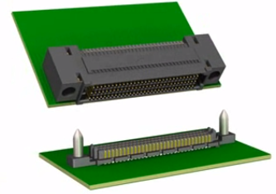
Right angle Searay™ Receptacle and backplane Connector
SEAF-RA
  Female Right Angle Design
  0.050” (1.27 mm) pitch
  P/N: S-SEAF-50-01-L-08-2-RA-GP-TR
SEAM
  Male Vertical Backplane Design
  0.050” (1.27mm) pitch
  Guide post option
  P/N: S-SEAM-50-2.0-S-08-2-A-GP-K-TR

Slide 31
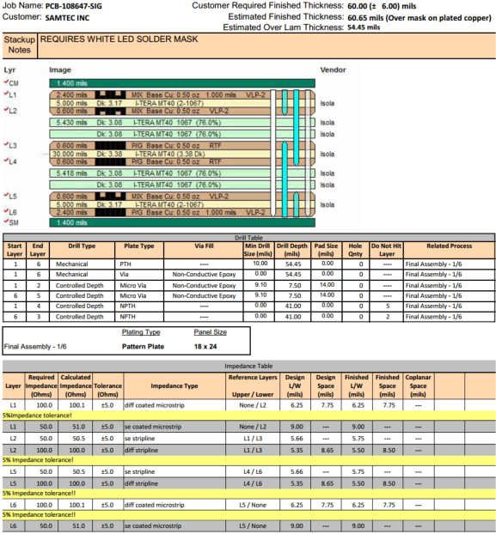
stackup

Slide 32
END

